Slide 1
Chapter 2 Elementary Programming

Slide 2
Introducing Programming with an Example
Listing 2.1 Computing the Area of a Circle
This program computes the area of the circle.
ComputeArea
Run

Slide 3
Trace a Program Execution
animation
allocate memory for radius
public class ComputeArea {
/** Main method */
public static void main(String[] args) {
double radius;
double area;
// Assign a radius
radius = 20;
// Compute area
area = radius * radius * 3.14159;
// Display results
System.out.println("The area for the circle of radius " +
radius + " is " + area);
}
}
radius
no value

Slide 4
Trace a Program Execution
animation
public class ComputeArea {
/** Main method */
public static void main(String[] args) {
double radius;
double area;
// Assign a radius
radius = 20;
// Compute area
area = radius * radius * 3.14159;
// Display results
System.out.println("The area for the circle of radius " +
radius + " is " + area);
}
}
memory
radius
no value
area
no value
allocate memory for area

Slide 5
Trace a Program Execution
animation
public class ComputeArea {
/** Main method */
public static void main(String[] args) {
double radius;
double area;
// Assign a radius
radius = 20;
// Compute area
area = radius * radius * 3.14159;
// Display results
System.out.println("The area for the circle of radius " +
radius + " is " + area);
}
}
assign 20 to radius
radius
20
area
no value

Slide 6
Trace a Program Execution
animation
public class ComputeArea {
/** Main method */
public static void main(String[] args) {
double radius;
double area;
// Assign a radius
radius = 20;
// Compute area
area = radius * radius * 3.14159;
// Display results
System.out.println("The area for the circle of radius " +
radius + " is " + area);
}
}
memory
radius
20
area
1256.636
compute area and assign it to variable area

Slide 7

Trace a Program Execution
animation
public class ComputeArea {
/** Main method */
public static void main(String[] args) {
double radius;
double area;
// Assign a radius
radius = 20;
// Compute area
area = radius * radius * 3.14159;
// Display results
System.out.println("The area for the circle of radius " +
radius + " is " + area);
}
}
memory
radius
20
area
1256.636
print a message to the console

Slide 8
Reading Input from the Console
1. Create a Scanner object
  Scanner input = new Scanner(System.in);
2. Use the methods next(), nextByte(), nextShort(), nextInt(), nextLong(), nextFloat(), nextDouble(), or nextBoolean() to obtain to a string, byte, short, int, long, float, double, or boolean value. For example,
  System.out.print("Enter a double value: ");
  Scanner input = new Scanner(System.in);
  double d = input.nextDouble();
ComputeAreaWithConsoleInput
ComputeAverage
Run
Run

Slide 9
Identifiers
An identifier is a sequence of characters that consist of letters, digits, underscores (_), and dollar signs ($).
An identifier must start with a letter, an underscore (_), or a dollar sign ($). It cannot start with a digit.
  An identifier cannot be a reserved word.
An identifier cannot be true, false, or
null.
An identifier can be of any length.

Slide 10
Variables
// Compute the first area
radius = 1.0;
area = radius * radius * 3.14159;
System.out.println("The area is “ + area + " for radius "+radius);
// Compute the second area
radius = 2.0;
area = radius * radius * 3.14159;
System.out.println("The area is “ + area + " for radius "+radius);

Slide 11
Declaring Variables
int x; // Declare x to be an
// integer variable;
double radius; // Declare radius to
// be a double variable;
char a; // Declare a to be a
// character variable;

Slide 12
Assignment Statements
x = 1; // Assign 1 to x;
radius = 1.0; // Assign 1.0 to radius;
a = 'A'; // Assign 'A' to a;

Slide 13
Declaring and Initializing in One Step
int x = 1;
double d = 1.4;

Slide 14
Constants
final datatype CONSTANTNAME = VALUE;
final double PI = 3.14159;
final int SIZE = 3;

Slide 15
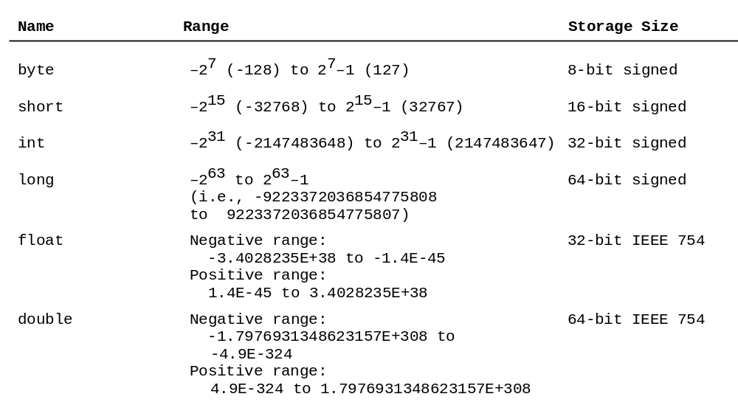
Numerical Data Types

Slide 16

Numeric Operators

Slide 17
Integer Division
+, -, *, /, and %
5 / 2 yields an integer 2.
5.0 / 2 yields a double value 2.5
5 % 2 yields 1 (the remainder of the division)

Slide 18

Remainder Operator
Remainder is very useful in programming. For example, an even number % 2 is always 0 and an odd number % 2 is always 1. So you can use this property to determine whether a number is even or odd. Suppose today is Saturday and you and your friends are going to meet in 10 days. What day is in 10 days? You can find that day is Tuesday using the following expression:

Slide 19
Problem: Displaying Time
Write a program that obtains hours and minutes from seconds.
DisplayTime
Run

Slide 20
NOTE
Calculations involving floating-point numbers are approximated because these numbers are not stored with complete accuracy. For example,
System.out.println(1.0 - 0.1 - 0.1 - 0.1 - 0.1 - 0.1);
displays 0.5000000000000001, not 0.5, and
System.out.println(1.0 - 0.9);
displays 0.09999999999999998, not 0.1. Integers are stored precisely. Therefore, calculations with integers yield a precise integer result.

Slide 21
Number Literals
A literal is a constant value that appears directly in the program. For example, 34, 1,000,000, and 5.0 are literals in the following statements:
int i = 34;
long x = 1000000;
double d = 5.0;

Slide 22
Integer Literals
An integer literal can be assigned to an integer variable as long as it can fit into the variable. A compilation error would occur if the literal were too large for the variable to hold. For example, the statement byte b = 1000 would cause a compilation error, because 1000 cannot be stored in a variable of the byte type.
An integer literal is assumed to be of the int type, whose value is between -2³¹ (-2147483648) to 2³¹–1 (2147483647). To denote an integer literal of the long type, append it with the letter L or l. L is preferred because l (lowercase L) can easily be confused with 1 (the digit one).

Slide 23
Floating-Point Literals
Floating-point literals are written with a decimal point. By default, a floating-point literal is treated as a double type value. For example, 5.0 is considered a double value, not a float value. You can make a number a float by appending the letter f or F, and make a number a double by appending the letter d or D. For example, you can use 100.2f or 100.2F for a float number, and 100.2d or 100.2D for a double number.

Slide 24
Scientific Notation
Floating-point literals can also be specified in scientific notation, for example, 1.23456e+2, same as 1.23456e2, is equivalent to 123.456, and 1.23456e-2 is equivalent to 0.0123456. E (or e) represents an exponent and it can be either in lowercase or uppercase.

Slide 25

Arithmetic Expressions
is translated to
(3+4*x)/5 – 10*(y-5)*(a+b+c)/x + 9*(4/x + (9+x)/y)

Slide 26

How to Evaluate an Expression
Though Java has its own way to evaluate an expression behind the scene, the result of a Java expression and its corresponding arithmetic expression are the same. Therefore, you can safely apply the arithmetic rule for evaluating a Java expression.

Slide 27

Problem: Converting Temperatures
Write a program that converts a Fahrenheit degree to Celsius using the formula:
FahrenheitToCelsius
Run

Slide 28

Problem: Displaying Current Time
Write a program that displays current time in GMT in the format hour:minute:second such as 1:45:19.
The currentTimeMillis method in the System class returns the current time in milliseconds since the midnight, January 1, 1970 GMT. (1970 was the year when the Unix operating system was formally introduced.) You can use this method to obtain the current time, and then compute the current second, minute, and hour as follows.
ShowCurrentTime
Run

Slide 29
Shortcut Assignment Operators
Operator Example Equivalent
+= i += 8 i = i + 8
-= f -= 8.0 f = f - 8.0
*= i *= 8 i = i * 8
/= i /= 8 i = i / 8
%= i %= 8 i = i % 8

Slide 30
Increment and
Decrement Operators
Operator Name Description
++var preincrement The expression (++var) increments var by 1 and evaluates
to the new value in var after the increment.
var++ postincrement The expression (var++) evaluates to the original value
in var and increments var by 1.
--var predecrement The expression (--var) decrements var by 1 and evaluates
to the new value in var after the decrement.
var-- postdecrement The expression (var--) evaluates to the original value
in var and decrements var by 1.

Slide 31


Increment and
Decrement Operators, cont.

Slide 32
Numeric Type Conversion
Consider the following statements:
byte i = 100;
long k = i * 3 + 4;
double d = i * 3.1 + k / 2;

Slide 33
Conversion Rules
When performing a binary operation involving two operands of different types, Java automatically converts the operand based on the following rules:
1. If one of the operands is double, the other is converted into double.
2. Otherwise, if one of the operands is float, the other is converted into float.
3. Otherwise, if one of the operands is long, the other is converted into long.
4. Otherwise, both operands are converted into int.

Slide 34
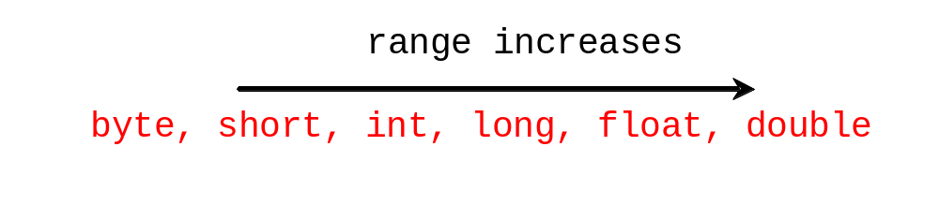
Type Casting
Implicit casting
double d = 3; (type widening)
Explicit casting
int i = (int)3.0; (type narrowing)
int i = (int)3.9; (Fraction part is truncated)

Slide 35
Character Data Type
Four hexadecimal digits.
char letter = 'A'; (ASCII)
char numChar = '4'; (ASCII)
char letter = '\u0041'; (Unicode)
char numChar = '\u0034'; (Unicode)
NOTE: The increment and decrement operators can also be used on char variables to get the next or preceding Unicode character. For example, the following statements display character b.
  char ch = 'a';
  System.out.println(++ch);

Slide 36

Unicode Format
Java characters use Unicode, a 16-bit encoding scheme established by the Unicode Consortium to support the interchange, processing, and display of written texts in the world’s diverse languages. Unicode takes two bytes, preceded by \u, expressed in four hexadecimal numbers that run from '\u0000' to '\uFFFF'. So, Unicode can represent 65535 + 1 characters.
Unicode \u03b1 \u03b2 \u03b3 for three Greek letters

Slide 37
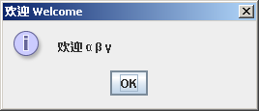
Problem: Displaying Unicodes
Write a program that displays two Chinese characters and three Greek letters.
DisplayUnicode
Run

Slide 38
Escape Sequences for Special Characters
Description Escape Sequence Unicode
Backspace \b \u0008
Tab \t \u0009
Linefeed \n \u000A
Carriage return \r \u000D
Backslash \\ \u005C
Single Quote \' \u0027
Double Quote \" \u0022

Slide 39
Casting between char and Numeric Types
int i = 'a'; // Same as int i = (int)'a';
char c = 97; // Same as char c = (char)97;

Slide 40
The String Type
The char type only represents one character. To represent a string of characters, use the data type called String. For example,
String message = "Welcome to Java";
String is actually a predefined class in the Java library just like the System class and JOptionPane class. The String type is not a primitive type. It is known as a reference type. Any Java class can be used as a reference type for a variable. Reference data types will be thoroughly discussed in Chapter 7, “Objects and Classes.” For the time being, you just need to know how to declare a String variable, how to assign a string to the variable, and how to concatenate strings.

Slide 41
String Concatenation
// Three strings are concatenated
String message = "Welcome " + "to " + "Java";
// String Chapter is concatenated with number 2
String s = "Chapter" + 2; // s becomes Chapter2
// String Supplement is concatenated with character B
String s1 = "Supplement" + 'B'; // s1 becomes SupplementB

Slide 42
Programming Style and Documentation
Appropriate Comments
Naming Conventions
Proper Indentation and Spacing Lines
Block Styles

Slide 43
Appropriate Comments
Include a summary at the beginning of the program to explain what the program does, its key features, its supporting data structures, and any unique techniques it uses.
Include your name, class section, instructor, date, and a brief description at the beginning of the program.

Slide 44
Naming Conventions
Choose meaningful and descriptive names.
Variables and method names:
  Use lowercase. If the name consists of several words, concatenate all in one, use lowercase for the first word, and capitalize the first letter of each subsequent word in the name. For example, the variables radius and area, and the method computeArea.

Slide 45
Naming Conventions, cont.
Class names:
  Capitalize the first letter of each word in the name. For example, the class name ComputeArea.
Constants:
  Capitalize all letters in constants, and use underscores to connect words. For example, the constant PI and MAX_VALUE

Slide 46
Proper Indentation and Spacing
Indentation
  Indent two spaces.
Spacing
  Use blank line to separate segments of the code.

Slide 47

Block Styles
Use end-of-line style for braces.

Slide 48
Programming Errors
Syntax Errors
  Detected by the compiler
Runtime Errors
  Causes the program to abort
Logic Errors
  Produces incorrect result

Slide 49
Syntax Errors
public class ShowSyntaxErrors {
public static void main(String[] args) {
i = 30;
System.out.println(i + 4);
}
}

Slide 50
Runtime Errors
public class ShowRuntimeErrors {
public static void main(String[] args) {
int i = 1 / 0;
}
}

Slide 51
Logic Errors
import java.util.Scanner; // Scanner is in java.util
public class ShowLogicErrors {
// Determine if a number is between 1 and 100 inclusively
public static void main(String[] args) {
// Prompt the user to enter a number
Scanner input = new Scanner(System.in);
System.out.print("Enter an integer: ");
int number = input.nextInt();
// Display the result
System.out.println("The number is between 1 and 100 inclusively? " + ((1 > number) && (number > 100)));
System.exit(0);
}
}

Slide 52
Debugging
Logic errors are called bugs. The process of finding and correcting errors is called debugging. A common approach to debugging is to use a combination of methods to narrow down to the part of the program where the bug is located. You can hand-trace the program (i.e., catch errors by reading the program), or you can insert print statements in order to show the values of the variables or the execution flow of the program. This approach might work for a short, simple program. But for a large, complex program, the most effective approach for debugging is to use a debugger utility.

Slide 53
Debugger
Debugger is a program that facilitates debugging. You can use a debugger to
Execute a single statement at a time.
Trace into or stepping over a method.
Set breakpoints.
Display variables.
Display call stack.
Modify variables.

Slide 54
JOptionPane Input
This book provides two ways of obtaining input.
Using the Scanner class (console input)
Using JOptionPane input dialogs

Slide 55
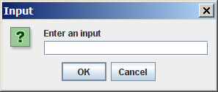
Getting Input from Input Dialog Boxes
String input = JOptionPane.showInputDialog(
"Enter an input");

Slide 56
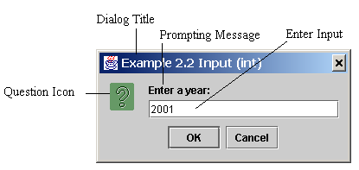
Getting Input from Input Dialog Boxes
String string = JOptionPane.showInputDialog(
null, “Prompting Message”, “Dialog Title”,
JOptionPane.QUESTION_MESSAGE);

Slide 57
Two Ways to Invoke the Method
There are several ways to use the showInputDialog method. For the time being, you only need to know two ways to invoke it.
One is to use a statement as shown in the example:
  String string = JOptionPane.showInputDialog(null, x,
  y, JOptionPane.QUESTION_MESSAGE);
where x is a string for the prompting message, and y is a string for the title of the input dialog box.
The other is to use a statement like this:
  JOptionPane.showInputDialog(x);
where x is a string for the prompting message.

Slide 58
Converting Strings to Integers
The input returned from the input dialog box is a string. If you enter a numeric value such as 123, it returns “123”. To obtain the input as a number, you have to convert a string into a number.
To convert a string into an int value, you can use the static parseInt method in the Integer class as follows:
int intValue = Integer.parseInt(intString);
where intString is a numeric string such as “123”.

Slide 59
Converting Strings to Doubles
To convert a string into a double value, you can use the static parseDouble method in the Double class as follows:
double doubleValue =Double.parseDouble(doubleString);
where doubleString is a numeric string such as “123.45”.

Slide 60
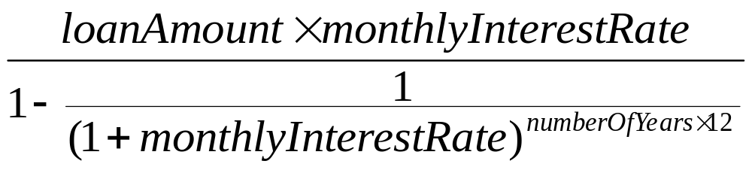
Problem: Computing Loan Payments Using Input Dialogs
program for computing loan payments, the input is entered from the input dialogs and the output is displayed in an output dialog.
ComputeLoanUsingInputDialog
Run

